Slide 1
Chapter 10
Leadership: Being an
Effective Project Manager

Slide 2
Managing versus Leading a Project
Managing—coping with complexity
  Formulate plans and objectives
  Monitor results
  Take corrective action
  Expedite activities
  Solve technical problems
  Serve as peacemaker
  Make tradeoffs among time, costs, and project scope
Leading—coping with change
  Recognize the need to change to keep the project on track
  Initiate change
  Provide direction and motivation
  Innovate and adapt as necessary
  Integrate assigned resources

Slide 3
Managing Project Stakeholders
Project Management Maxims:
  You can’t do it all and get it all done
    Projects usually involve a vast web of relationships.
  Hands-on work is not the same as leading.
    More pressure and more involvement can reduce your effectiveness as a leader.
  What’s important to you likely isn’t as important to someone else
    Different groups have different stakes (responsibilities, agendas, and priorities) in the outcome of a project.
  Remember: project management is tough, exciting, and rewarding—endeavor to persevere.

Slide 4
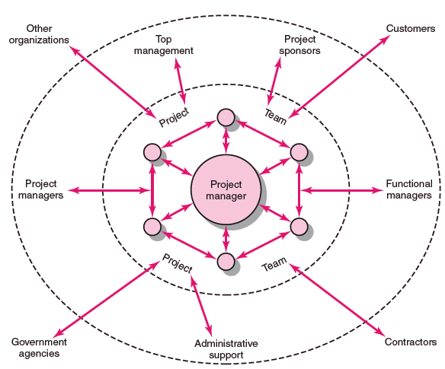
Network of Stakeholders
FIGURE 10.1

Slide 5
Influence as Exchange
The Law of Reciprocity
  One good deed deserves another, and likewise, one bad deed deserves another.
Quid pro Quo
  Mutual exchanges of resources and services (“back-scratching”) build relationships.
Influence “Currencies” (Cohen and Bradford)
  Cooperative relationships are built on the exchange of organizational “currencies” (favors).

Slide 6
Commonly Traded Organizational Currencies
Task-related currencies
  Resources Lending or giving money, budget increases, personnel, etc.
  Assistance Helping with existing projects or undertaking unwanted tasks.
  Cooperation Giving task support, providing quicker response time, or aiding implementation.
  Information Providing organizational as well as technical knowledge.
Position-related currencies
  Advancement Giving a task or assignment that can result in promotion.
  Recognition Acknowledging effort, accomplishments, or abilities.
  Visibility Providing a chance to be known by higher-ups or significant others in the organization.
  Network/contacts Providing opportunities for linking with others.
Source: Adapted from A. R. Cohen and David L. Bradford, Influence without Authority
(New York: John Wiley & Sons, 1990). Reprinted by permission of John Wiley & Sons, Inc.
TABLE 10.1

Slide 7
Commonly Traded Organizational Currencies (cont’d)
Inspiration-related currencies
  Vision Being involved in a task that has larger significance for the unit, organization, customer, or society.
  Excellence Having a chance to do important things really well.
  Ethical correctness Doing what is “right” by a higher standard than efficiency.
Relationship-related currencies
  Acceptance Providing closeness and friendship.
  Personal support Giving personal and emotional backing.
  Understanding Listening to others’ concerns and issues.
Personal-related currencies
  Challenge/learning Sharing tasks that increase skills and abilities.
  Ownership/involvement Letting others have ownership and influence.
  Gratitude Expressing appreciation.
Source: Adapted from A. R. Cohen and David L. Bradford, Influence without Authority
(New York: John Wiley & Sons, 1990). Reprinted by permission of John Wiley & Sons, Inc.
TABLE 10.1 (cont’d)

Slide 8
Social Network Building
Mapping Dependencies
  Project team perspective:
    Whose cooperation will be needed?
    Whose agreement or approval will we need?
    Whose opposition would keep us from accomplishing the project?
  Stakeholders’ perspective:
    What differences exist between the team and those on whom the team will depend?
    How do the stakeholders view the project?
    What is the status of our relationships with the stakeholders?
    What sources of influence does the team have relative to the stakeholders?

Slide 9
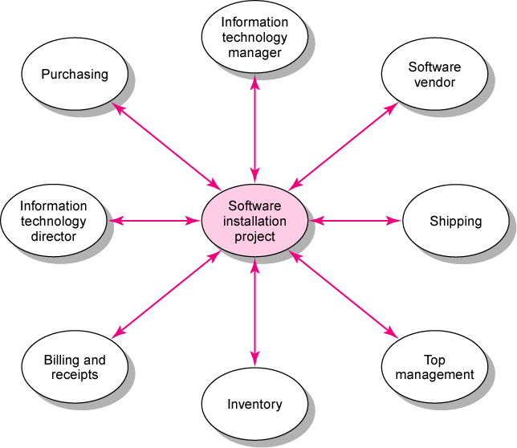
Dependencies for Financial Software Installation Project
FIGURE 10.2

Slide 10
Management by Wandering Around (MBWA)
Management by Wandering Around (MBWA)
  A management style that involves managers spending the majority of time outside of their offices in face-to-face interactions with employees building cooperative relationships.
Characteristics of Effective Project Managers
  Initiate contact with key players.
  Anticipate potential problems.
  Provide encouragement.
  Reinforce the objectives and vision of the project.
  Intervene to resolve conflicts and prevent stalemates.

Slide 11
Managing Upward Relations
Project Success = Top Management Support
  Appropriate budgets
  Responsiveness to unexpected needs
  A clear signal to the organization of the importance of cooperation
Motivating the Project Team
  Influence top management in favor of the team:
    Rescind unreasonable demands
    Provide additional resources
    Recognize the accomplishments of team members

Slide 12
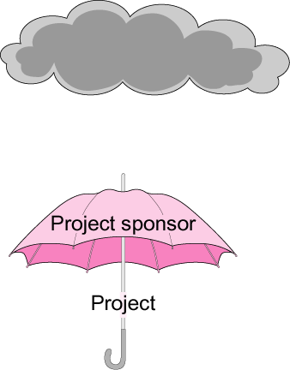
The Significance of a Project Sponsor
FIGURE 10.3

Slide 13
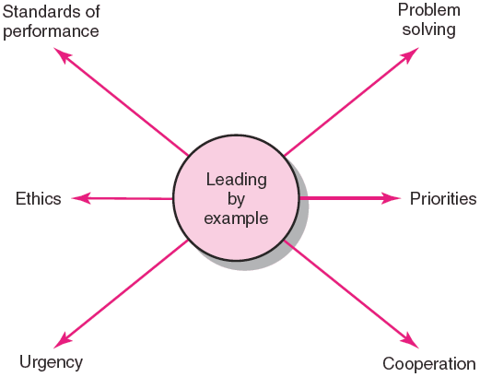
Leading by Example
FIGURE 10.4

Slide 14
Ethics and Project Management
Ethical dilemmas
  Situations where it is difficult to determine whether conduct is right or wrong.
    Padding of cost and time estimations
    Exaggerating pay-offs of project proposals
    Falsely assuring customers that everything is on track
    Being pressured to alter status reports
    Falsifying cost accounts
    Compromising safety standards to accelerate progress
    Approving shoddy work
  Code of conduct
    Professional standards and personal integrity

Slide 15

Contradictions of Project Management
Innovate and maintain stability.
See the big picture while getting your hands dirty.
Encourage individuals but stress the team.
Hands-off/Hands-on.
Flexible but firm.
Team versus organizational loyalties.

Slide 16

Qualities of an Effective Project Manager
Systems thinker
Personal integrity
Proactive
High tolerance for stress
General business perspective
Good communicator
Effective time management
Skillful politician
Optimist

Slide 17

Suggestions for Project Managers
Build relationships before you need them.
Be leery of the Golden Rule.
Trust is sustained through frequent face-to-face contact.

